Slide 1
Adaptive and Equitable Water Supply Planning Under Uncertainty
Sarah Fletcher
Assistant Professor, Stanford University

Slide 2
Agenda
Sarah
Overview of field and methods
Some example projects
Synthetic streamflow generation for climate impact analysis
Jenny
Literature on climate uncertainty and hydropower
Research interests
Discussion
Notes:
https://hess.copernicus.org/articles/25/3105/2021/

Slide 3
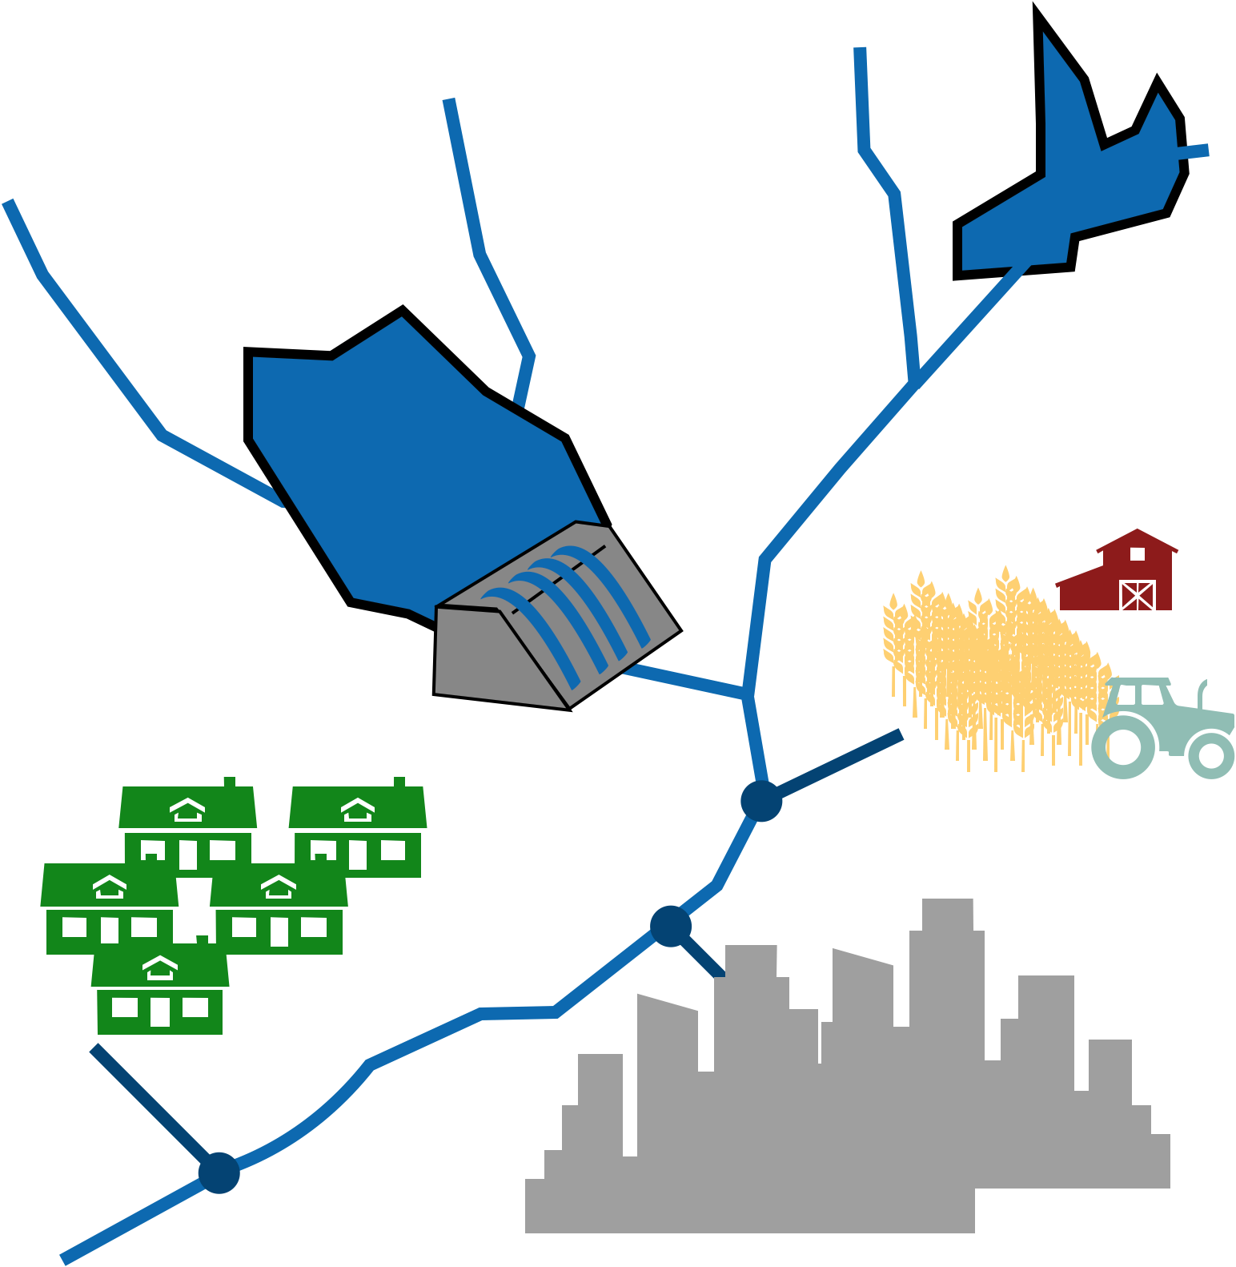
Water Resource Systems Analysis
Performance metrics: cost, reliability by sector, environmental flows

Slide 4
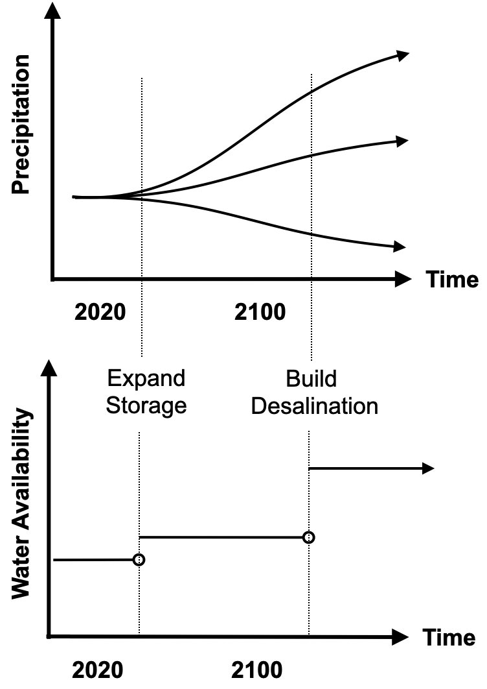
Our Field: Water Resources Systems Analysis
Examples
What capacity expansions should we plan given uncertainty in long-term climate impacts?
What short- or long-term adaptation triggers should we use to ensure robustness to climate change?
How do supply portfolios stand up to mild, prolonged droughts vs short, intense droughts?
When should demand management be implemented?
How should reservoir operations be adapted as the climate changes?

Slide 5
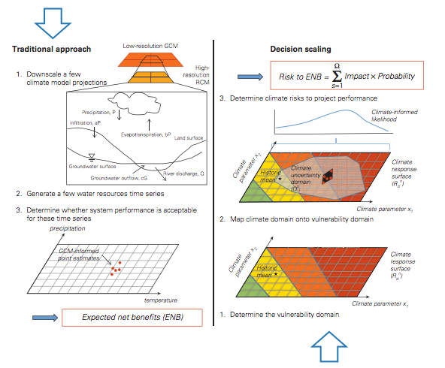
Decision Making Under Deep Uncertainty
Top down
e.g. RDM
Bottom up
Source: Ray and Brown, “Confronting Climate Uncertainty in Water Resources Planning and Project Design: The Decision Tree Framework”, World Bank Group, 2015.

Slide 6
Climate adaptation as a control problem
Herman, Quinn, Steinscheinder, Giuliani, and Fletcher (2020). “Climate Adaptation as a Control Problem: Review and Perspectives on Dynamic Water Resources Planning Under Uncertainty.” Water Resources Research.

Slide 7
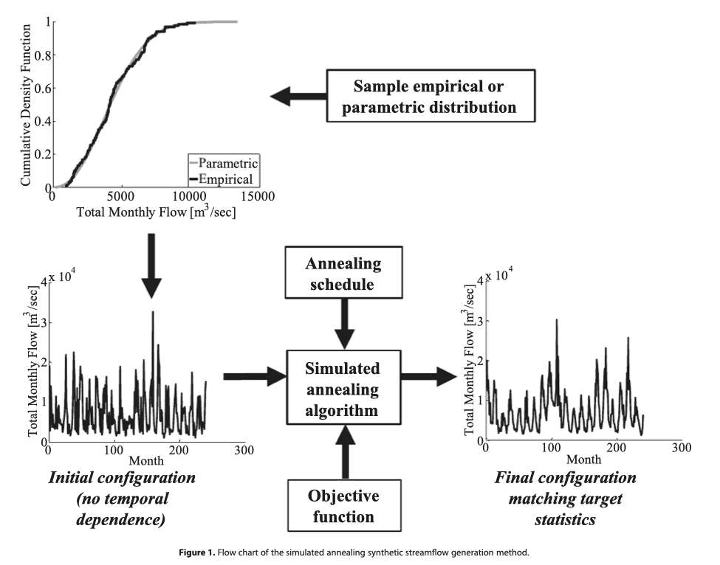
Synthetic streamflow generation
Reconstruct empirical distribution from historical streamflow data
Extract random series from empirical distribution
Recombine random series to generate a synthetic streamflow series that matches desired properties
Borgomeo, E., Farmer, C. L., & Hall, J. W. (2015). Numerical rivers: A synthetic streamflow generator for water resources vulnerability assessments. Water Resources Research, 51(7), 5382-5405.
Notes:
We do that using a very cool drought generator published in the paper cited below that looks like this…

Slide 8
Learning about climate change uncertainty to target infrastructure investments for climate adaptation
Precipitation change in Mombasa
Updating Uncertainty over Time
Adaptive Reservoir Expansion
Cost (including shortages)
Fletcher et al. 2019 Nature Comm
Lower Learning over Time
?
Skerker et al., in prep

Slide 9
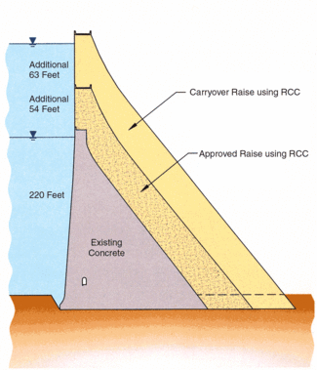
Learning about climate change uncertainty to target infrastructure investments for climate adaptation
Precipitation change in Mombasa
Updating Uncertainty over Time
Adaptive Reservoir Expansion
Cost (including shortages)
Fletcher et al. 2019 Nature Comm
How do different types of flexibility interact in managing climate uncertainty?
Keani Willebrand and Sarah Fletcher
Planning
Design
Operations

Slide 10



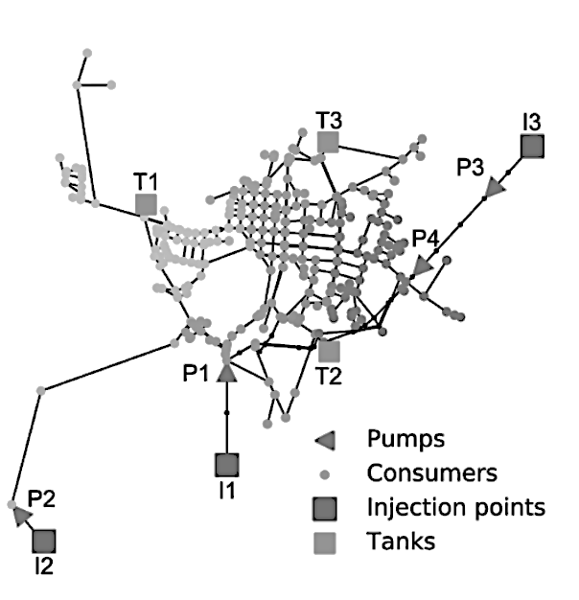
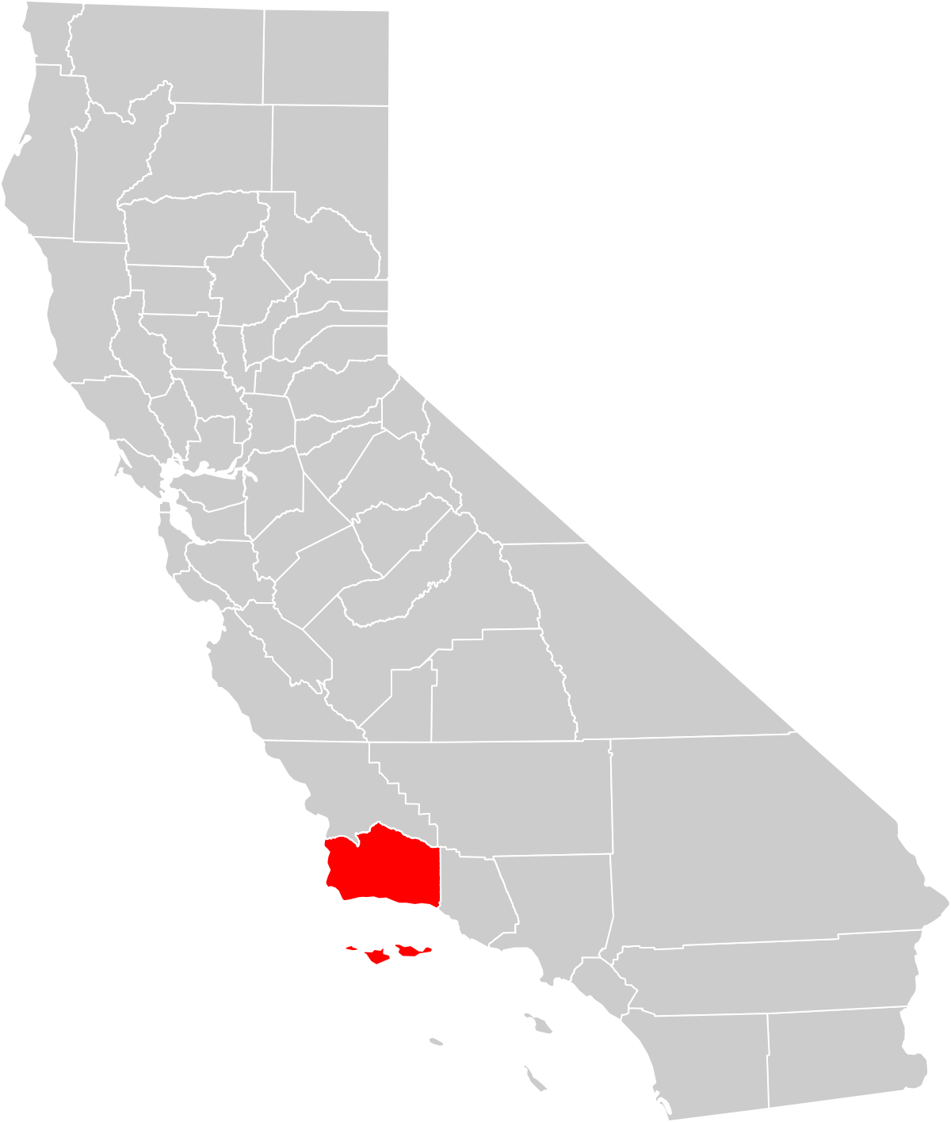
Bridging scales for technology pathways to urban drought resilience
Basin-Scale Water Resources Planning
Current and future drought scenarios
Current and future technological scenarios
Urban-Scale Distribution and Technology Characterization
Severity
Persistence
Robust Decision Making Under Uncertainty
Hydrological model
Urban model
case study
Santa Barbara
Robust pathways of supply expansion (cost, efficiency, emissions)
Understand relation between tech attributes and droughts
Zaniolo, Fletcher, and Mauter, in prep
Notes:
I’m working on the issue of building urban water resilience in Cali that is struggling with this given the increase in severity and frequency of droughts as well as population + demand.
But cities also struggle in justifying large investments on expensive water production tech like ocean desalination plants, especially once the drought end and natural supply sources are no longer constrained.
So we have a difficult planning problem characterized by large uncertainty in climate and demand, and the consideration that short term drought solutions that may be taken during drought must reconcile with long term goals of cost-effectiveness and resilience
The literature in our field has looked the problem via robust DM under uncertainty, to identify decisions that are robust among many futures and hydrological signpost that trigger the implementation of a drought solution.
However, these studies typically operate at a large scale, regional or basin level, and only allow for a coarse characterization of the many water solutions that are available to cities.
So with this work we want to go in that direction, and really refine the tech assumptions moving from one or few prespecified options of capacity expansion to considering numerous water production and reuse technologies and policies solutions, like SW desal, potable and NP reuse, with centralized or decentralized options, targeted conservation of efficiency measures. So from large concentrated capacity expansions but also modular small scale solutions that build capacity incrementally.
We do this with a multiscale model from watershed to end-use that allows to consider the climate but also the urban distributional aspects and the integration between centralized and decentralized tech.
We not only consider current sota tech, but also scenarios of future tech by marginally improving various tech attributes, like energy intensity, capital costs, modularity potential, etc.
Our results are intended to inform urban planning, on cost-effective, climate responsive expansion of the supply portfolio, but also guide tech innovation by understanding what tech attributes are most valuable to tackle droughts of different intensity and durations.

Slide 11
Some plots
Low severity, high persistence
high severity, low persistence

Slide 12
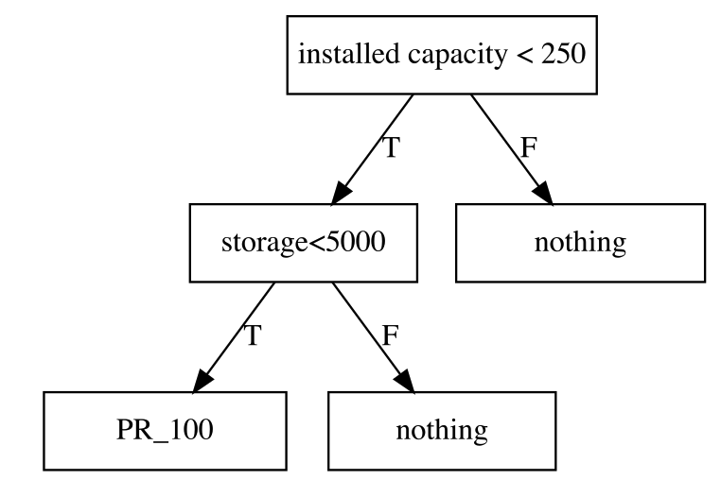
Through simulation, we associate a policy with a performance, then optimize using evolutionary algorithm
Simulate for the entire time horizon, and for multiple scenarios
deficit
cost
Zaniolo, Fletcher, and Mauter, in prep
J def
J cost
Notes:
So now we simulated the whole trajectory, and we can compute indicators,

